Slide 1
Pallapati pavan kumar
Lovely Professional University
punjab , jalandhar,144411
reg num: 12217293
mail: yadavpavankumar319@gmail.com

Slide 2

Emotion Recognition from Facial Expressions
An exploration into understanding and quantifying human emotions through facial analysis.

Slide 3
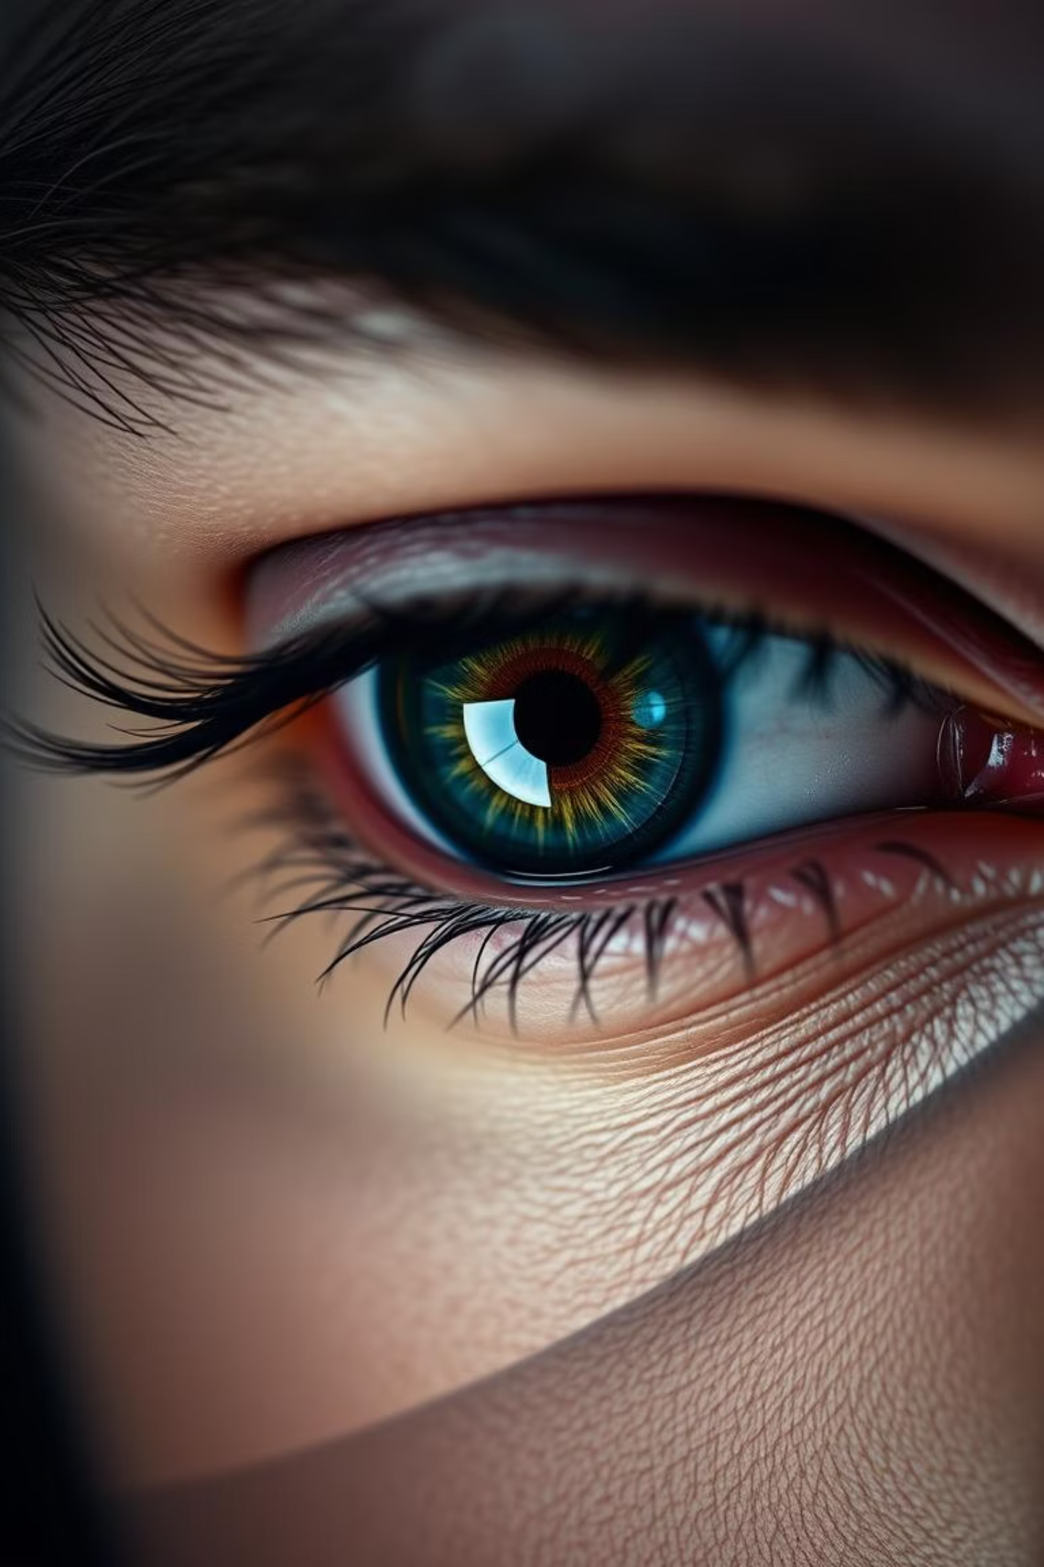
What is Emotion Recognition?
Emotion recognition is a software technique that analyzes human faces using advanced image processing and sophisticated algorithms. It aims to "read" emotions and determine the probabilities of mixed emotions a person might be experiencing.

Slide 4

Installation Guide
To get started, you'll need to install the necessary dependencies. This can be done easily by using the provided requirements file.
pip install -r requirements.txt

Slide 5
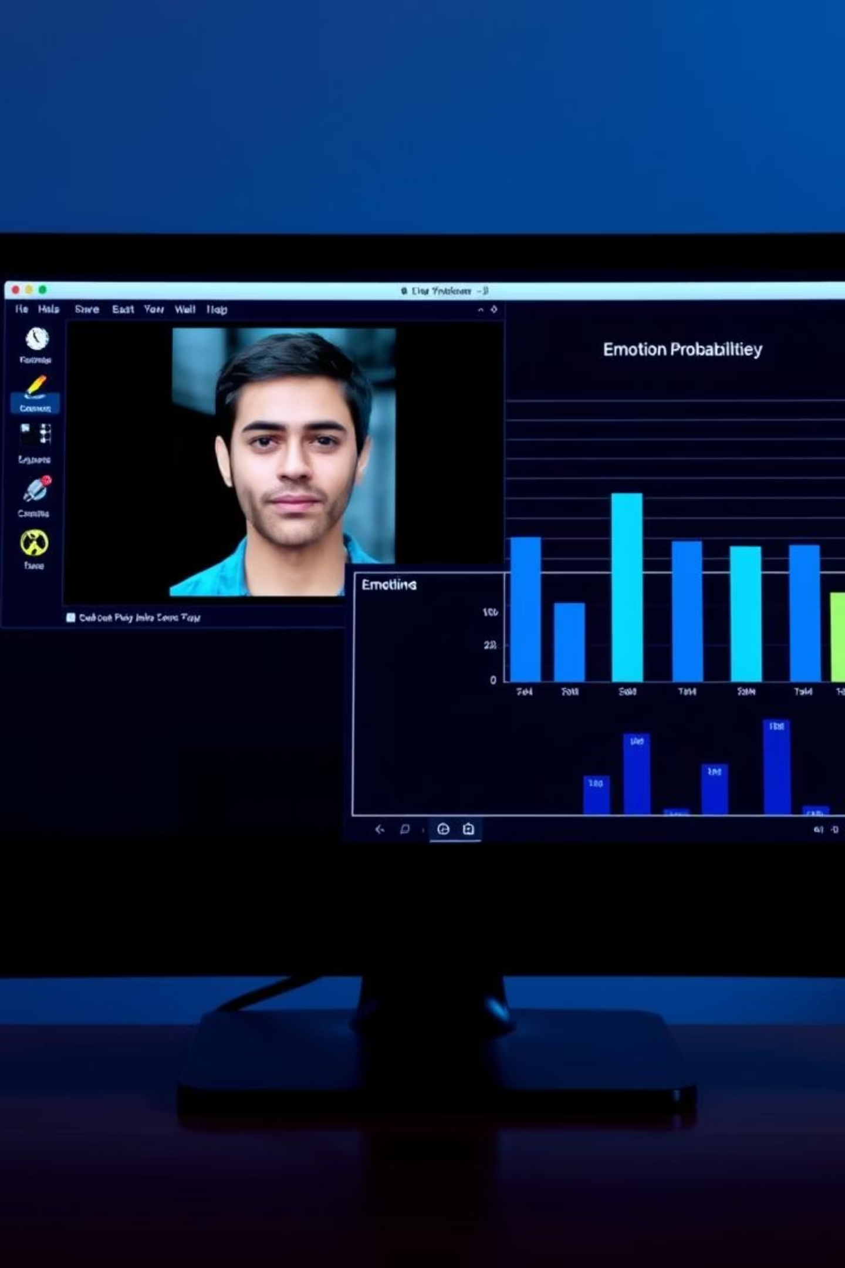
How to Use the Application
Run the real-time video script to launch the application. A window will display your webcam feed, while another will show the detected emotional probabilities.
python real_time_video.py
The included pretrained model offers the best accuracy. For custom models, you may need to run the training script.

Slide 6
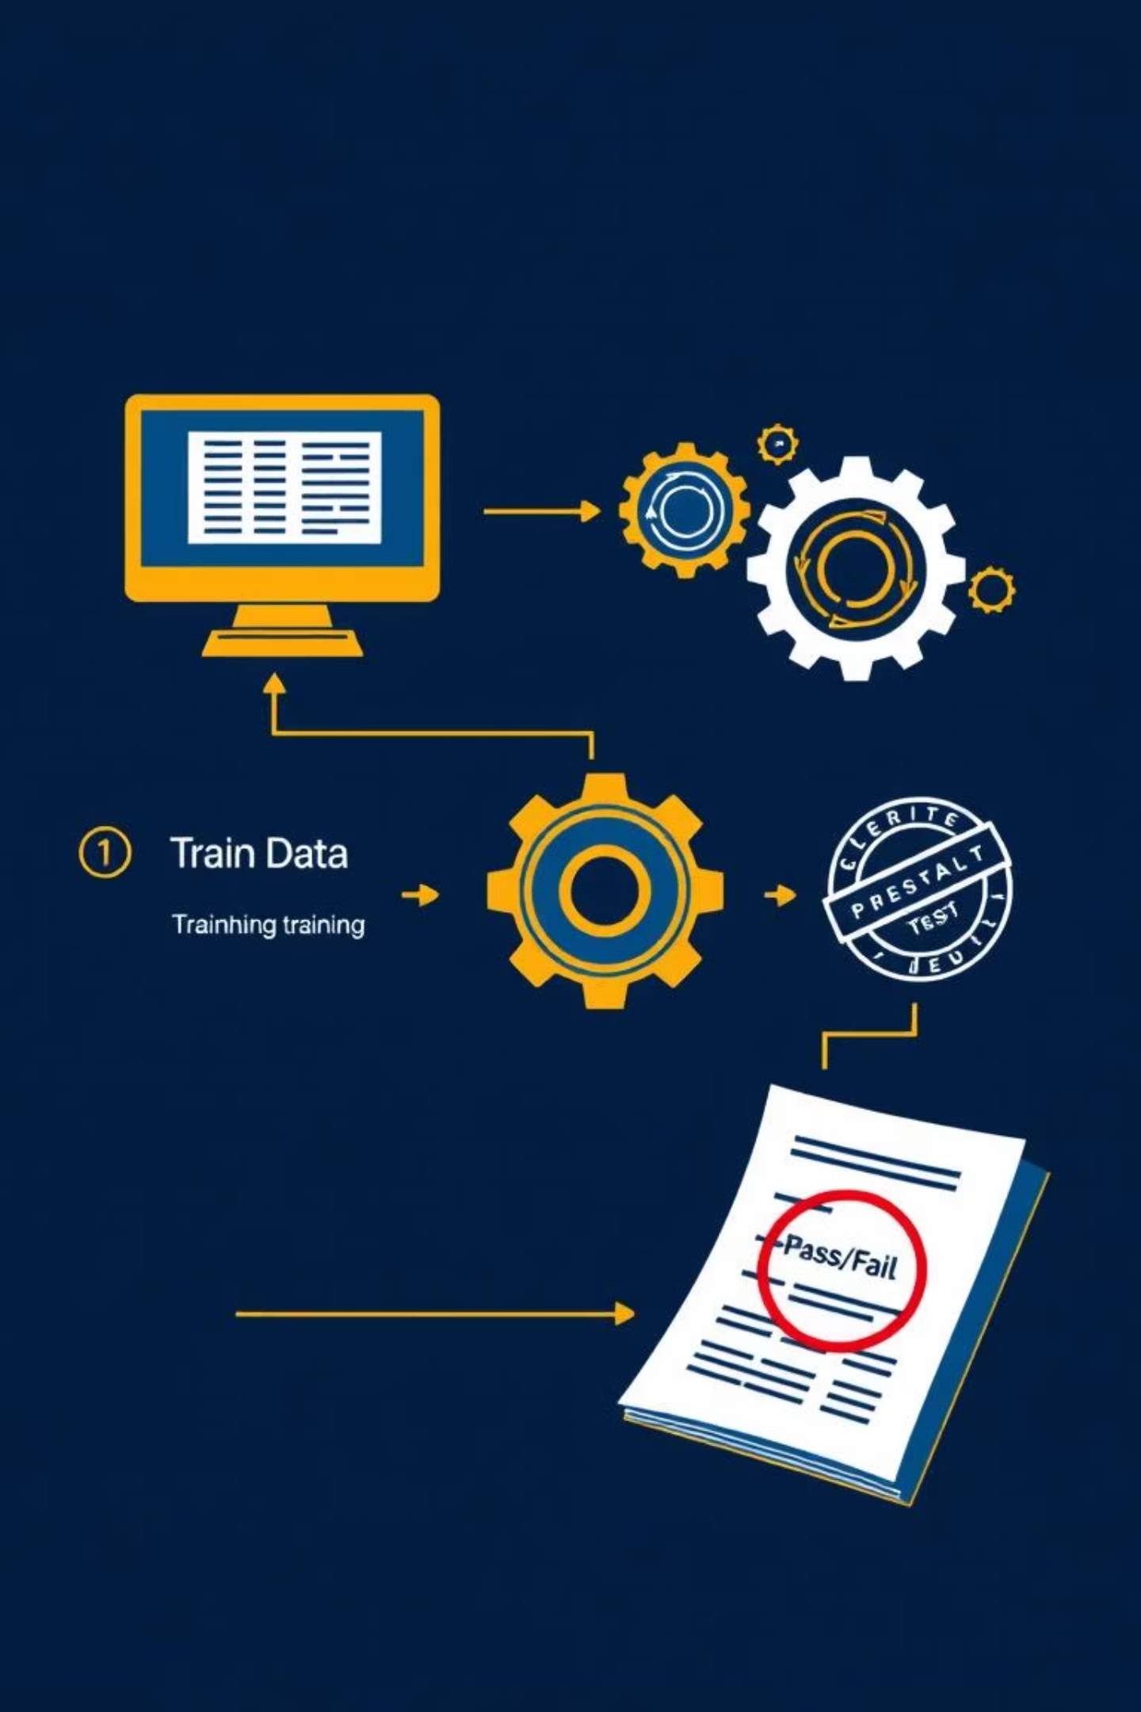
Training the Emotion Classifier
If you wish to train your own emotion classifier or use a different model, you can execute the following script. This allows for customization and experimentation with various models.
python train_emotion_classifier.py

Slide 7

Dataset Utilized
The project utilizes a dataset available on Kaggle for emotion classification. After downloading, place the CSV file in the specified directory.
fer2013 dataset
The current test accuracy for fer2013 emotion classification is 66%.

Slide 8

Inspiration and Credits
This work draws significant inspiration from existing projects and valuable resources in the field of facial analysis and machine learning.
Inspired by: oarriaga/face_classification
Assisted by resources from Adrian Rosebrock.

Slide 9
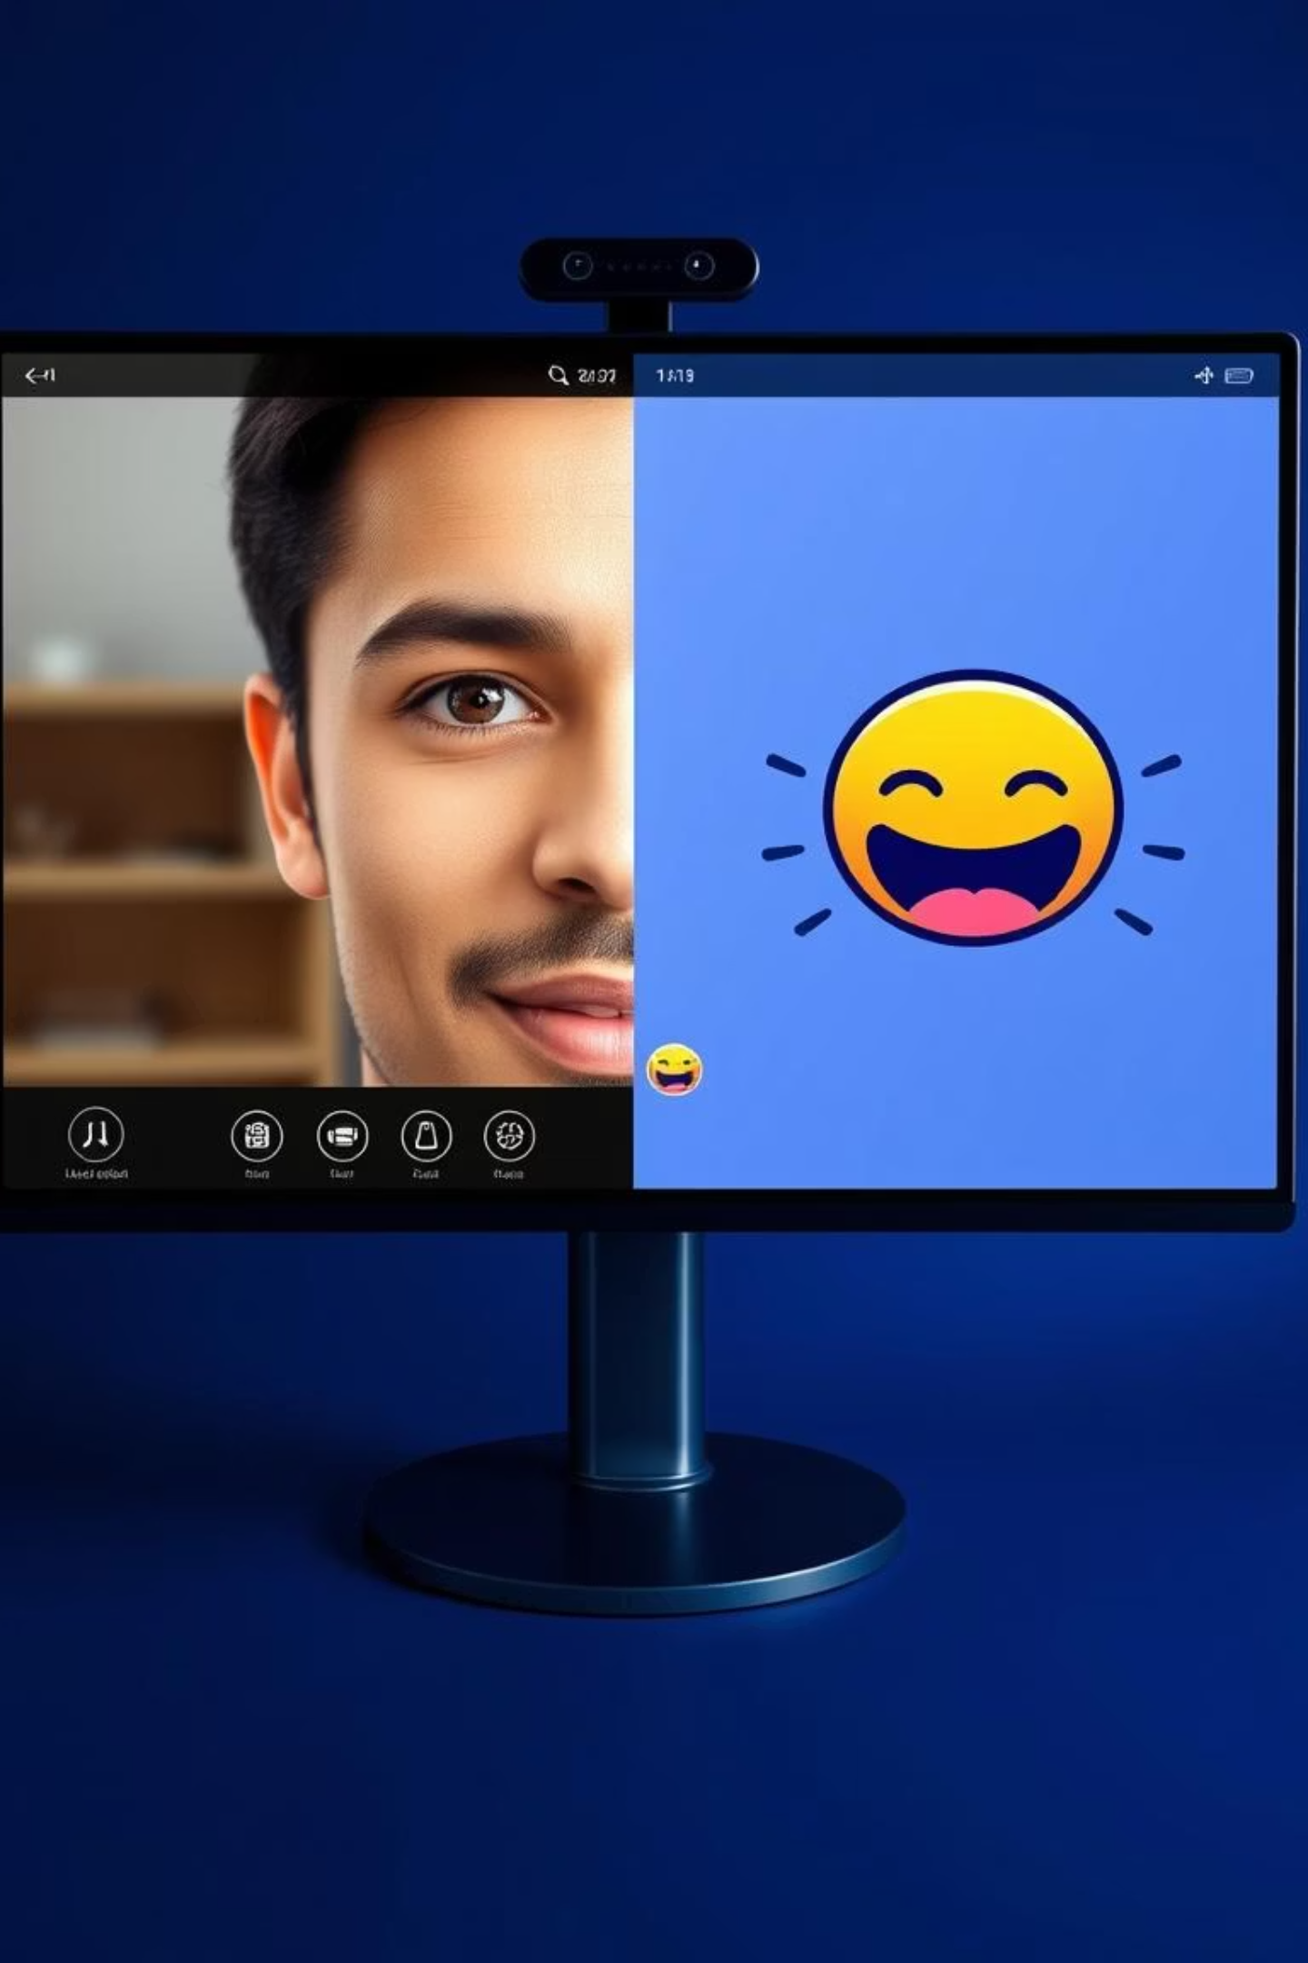
Future Enhancements
An exciting ongoing development includes drawing emotion faces directly next to the detected face in the application's interface. This will provide a more intuitive and visually direct representation of the analysis.

